Slide 1
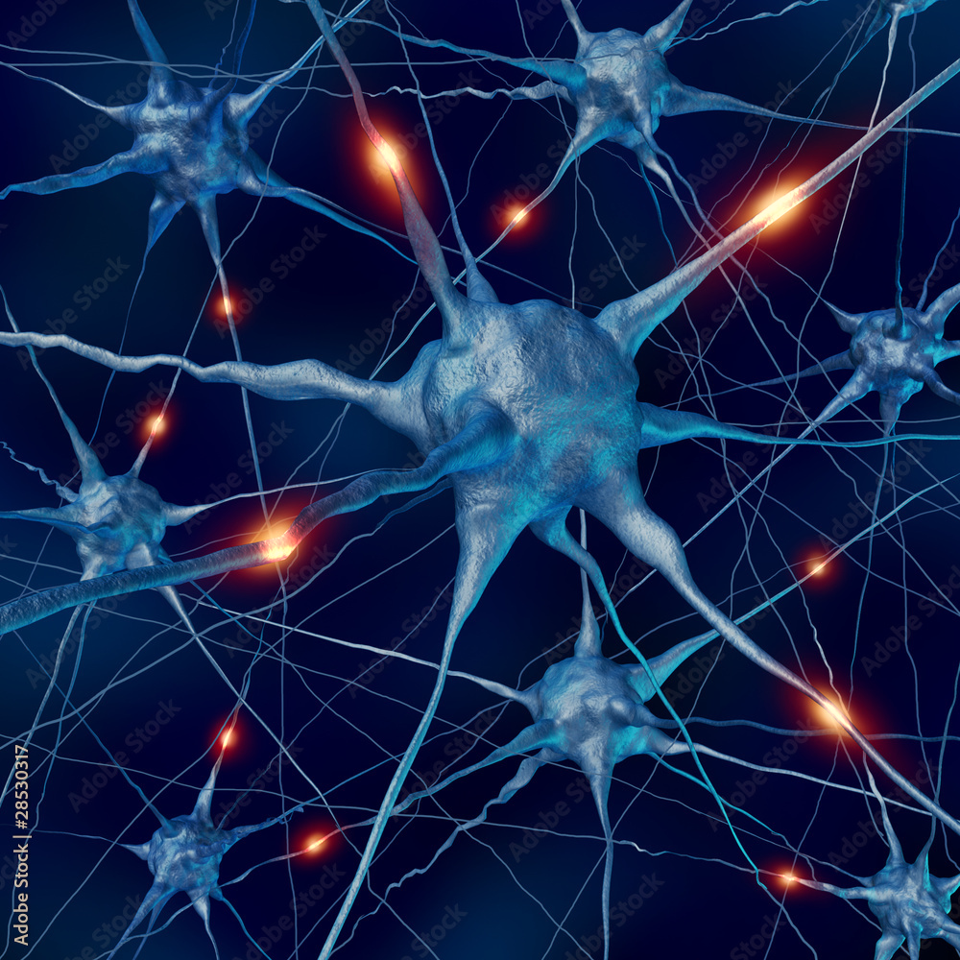
Classification of Neurons and their Function in Biological Networks
Final Project-Applied Data Science 2023
Liran Kalderon
Avia Ben Zvi
Dafna Levenberg

Slide 2
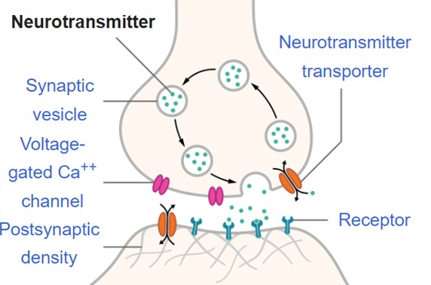
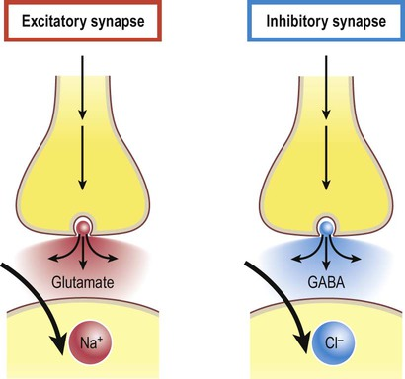
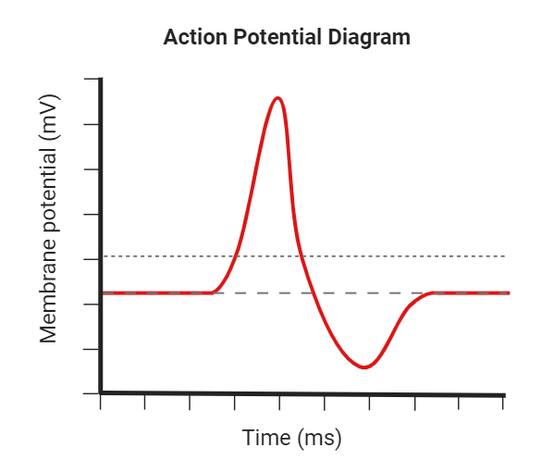
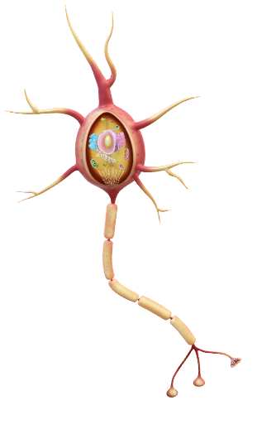
Overview
Neuronal communication- electrochemical signaling
Neuron
Synapse
Excitation (+) / Inhibition (-)

Slide 3

Motivation
Neuron type classification
Classification of neuron types based on their electrical activity patterns- why?
Essential for understanding complex brain processes
May provide a basis for detecting healthy or diseased neurons in the future
An important milestone for the development of different therapeutic strategies (e.g., Parkinson’s disease)

Slide 4
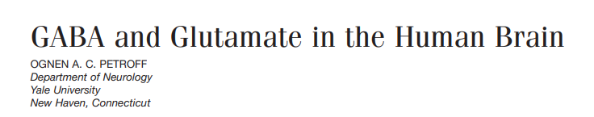
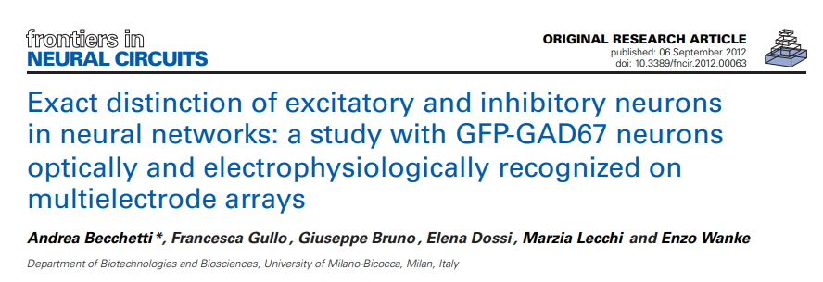
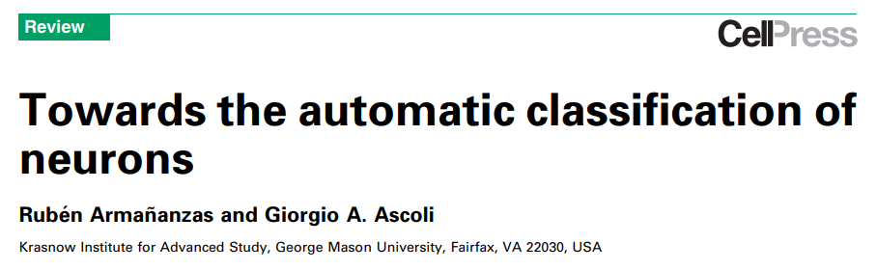
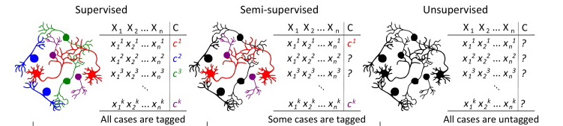
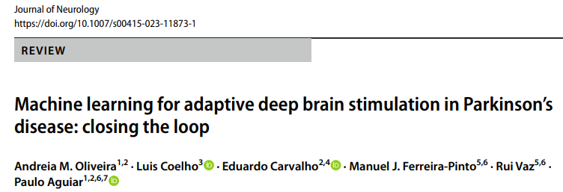
Related Work

Slide 5
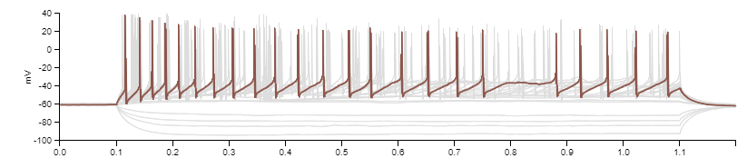
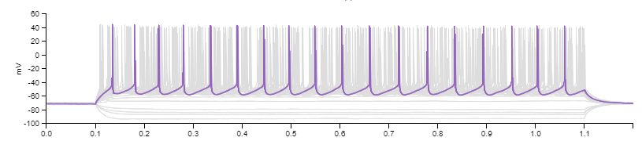
Initial Questions
Can we distinguish neuron type- inhibitory or excitatory- based on its electrical activity?
Considerations:
Which features are relevant for classification?
Which ML approach should be used?
Inhibitory- GABAergic
Excitatory- Glutamatergic

Slide 6
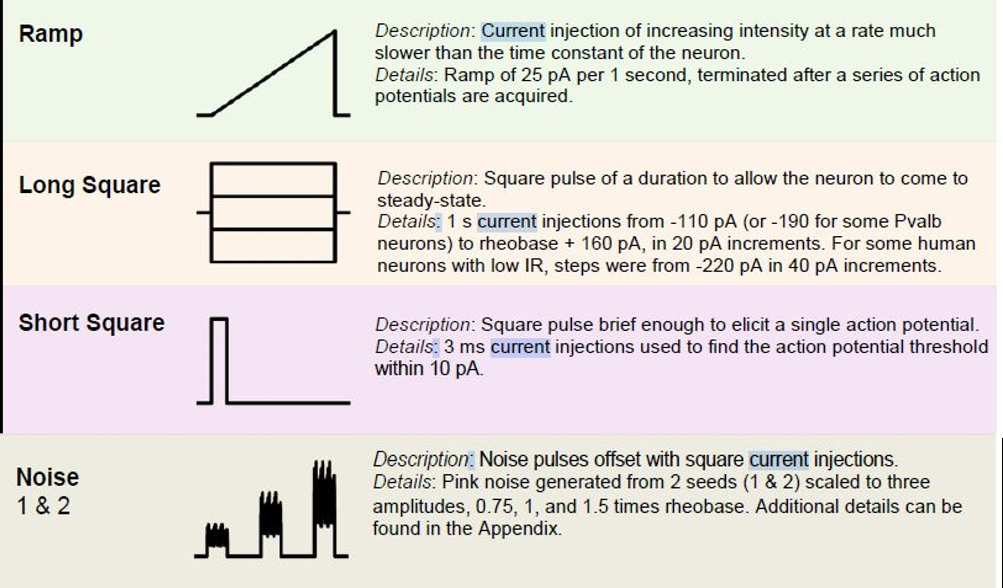
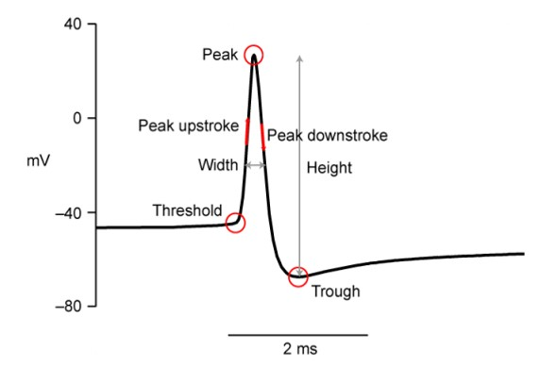
Data
Source and description
Taken from Allen cell-type website (open source)
Electrical recordings of mice cortical neurons’ activity + Neuron properties
The electrical activity of the neurons in response to four different types of electrical stimulation was recorded
Raw data: voltage as a function of time → Tabular data: activity features

Slide 7
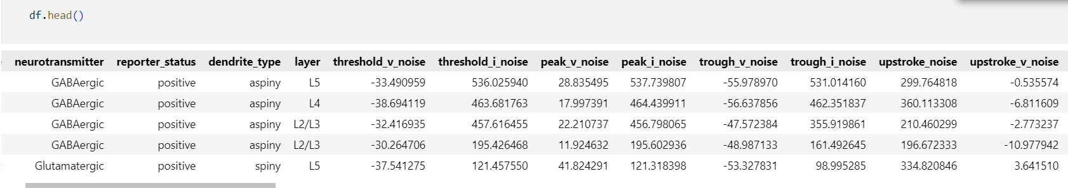
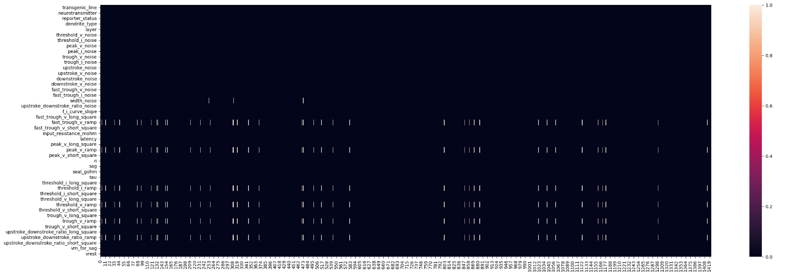
Data
Data description and cleaning
45 Features:
4 categorial
41 numerical
Binary label:
GABAergic (inhibitory)
Glutamatergic (excitatory)
1424 observations
Cleanup:
missing values detection & mean imputation

Slide 8
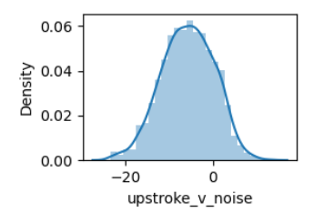
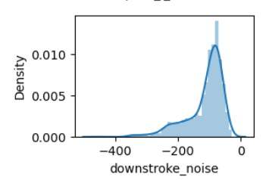
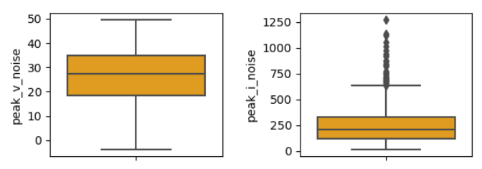
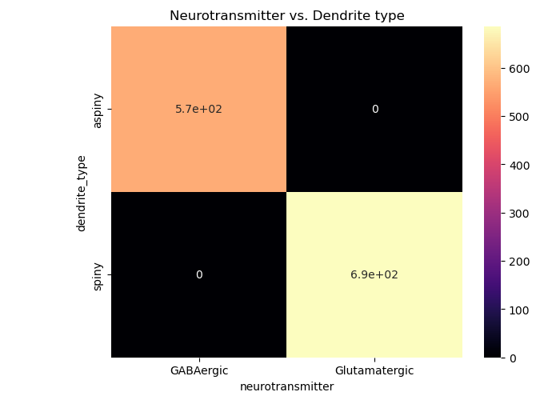
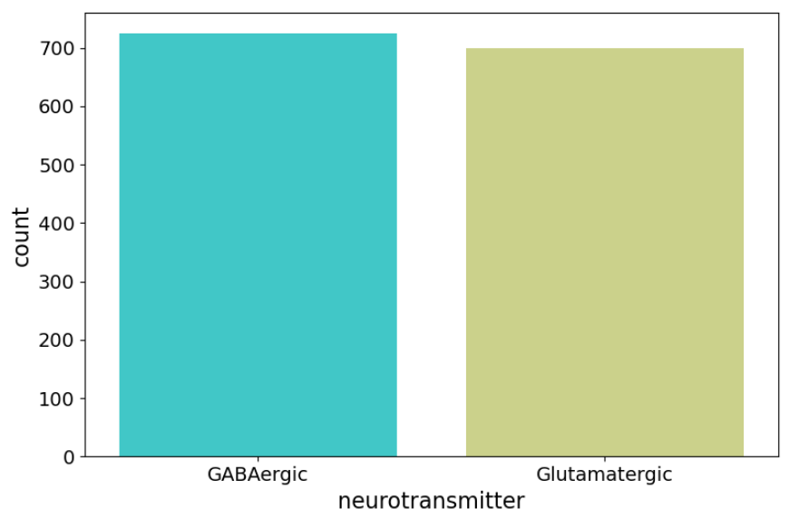
Exploratory Data Analysis
Descriptive statistics
Extreme outliers were removed (~11.9% of the data)
1254 observations remained
Most features are not normally distributed
Two label groups are similar in size
Categorial features with perfect correlation to the label were removed

Slide 9
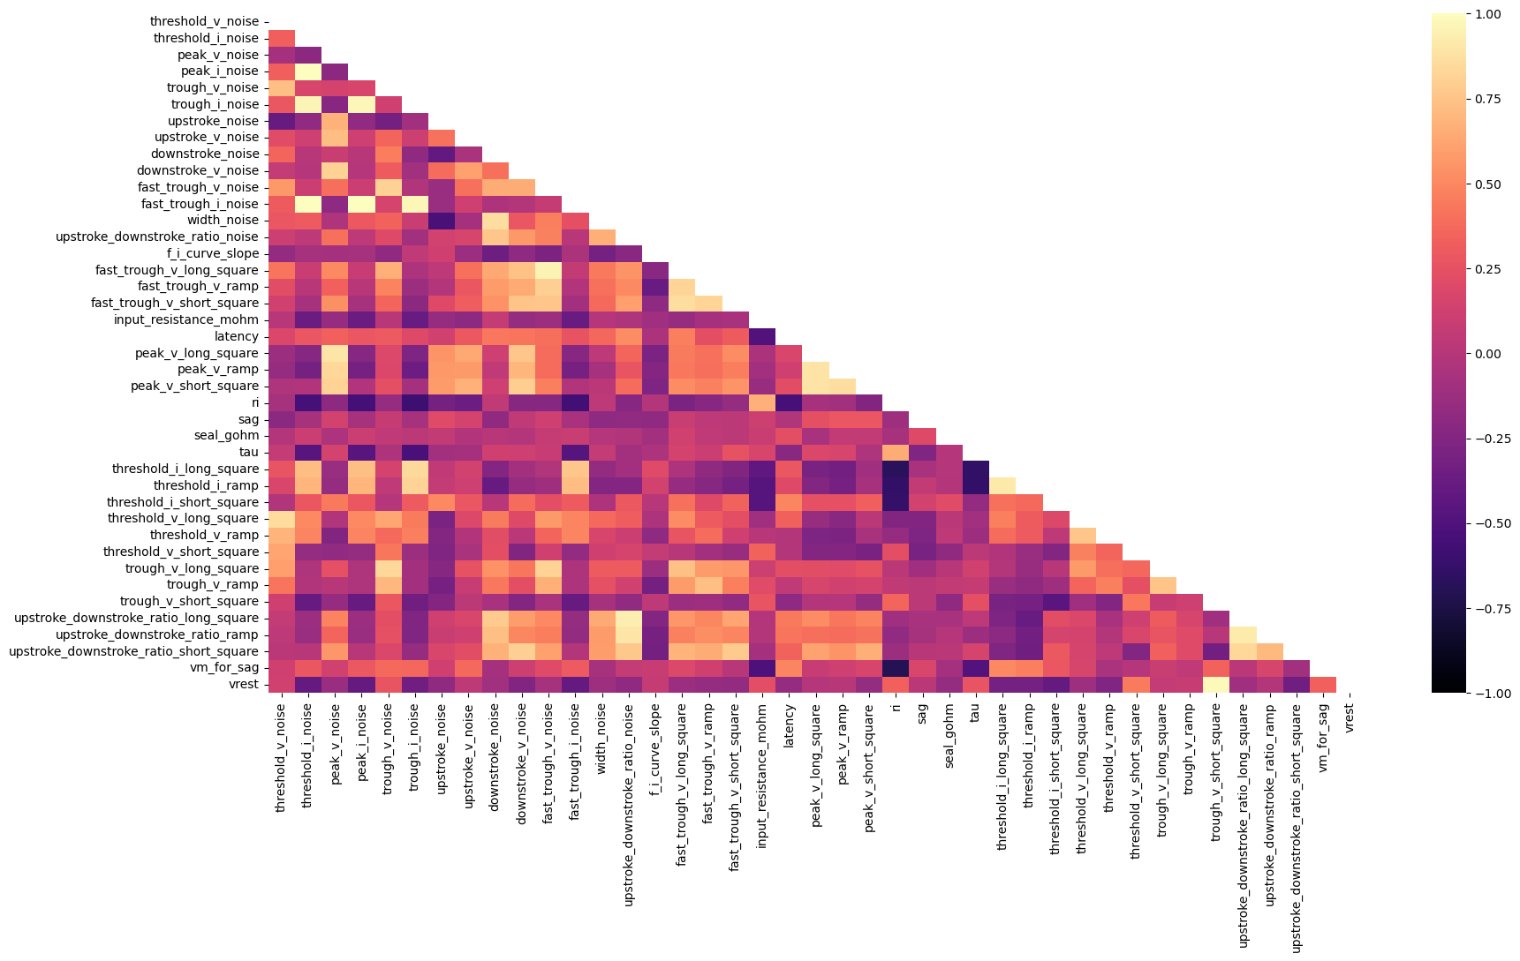
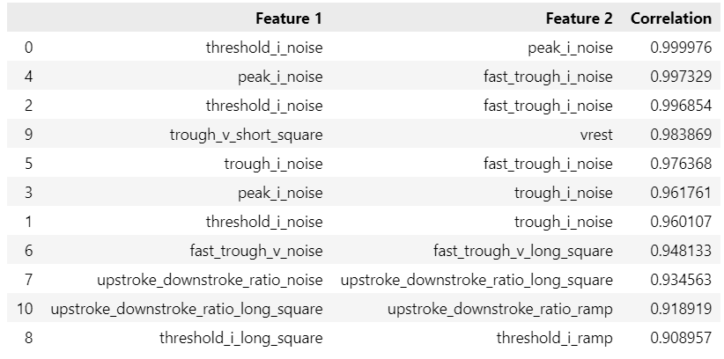
Exploratory Data Analysis
Correlations in the data- between features
Most correlated features (r > 0.9)

Slide 10
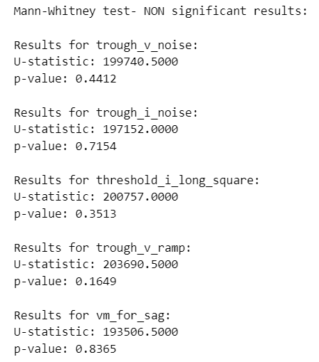
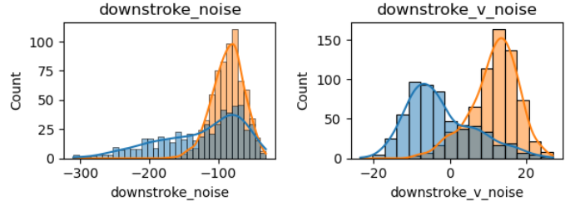
Exploratory Data Analysis
Correlations in the data- with the label
Distributions of the features based on their label ('neurotransmitter’)
Most features are not normally distributed
Mann-Whitney test
Results with p-value>0.05 are presented

Slide 11
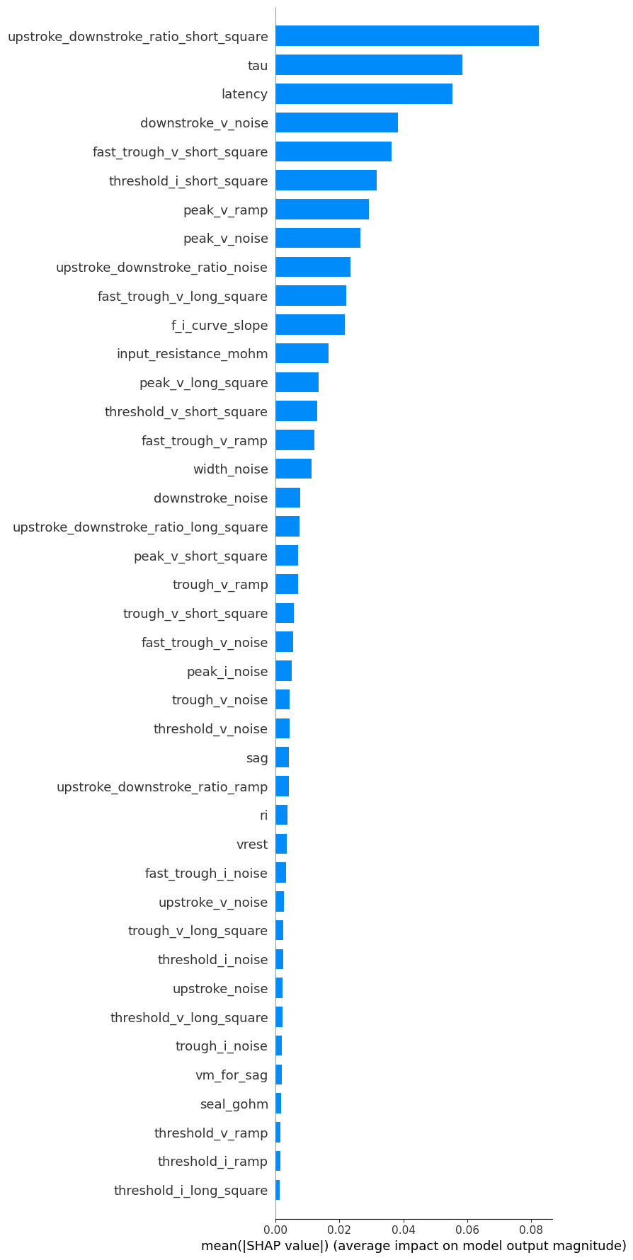

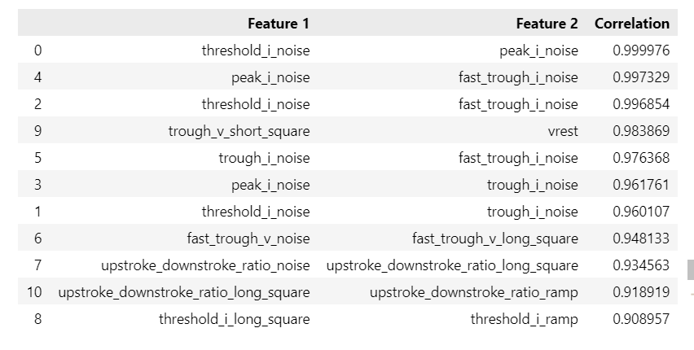
Exploratory Data Analysis
Feature importance- SHAP
Source data Filtered data
42 features → 17 features
Removed based on:
Feature Corr
Mann-Whitney

Slide 12
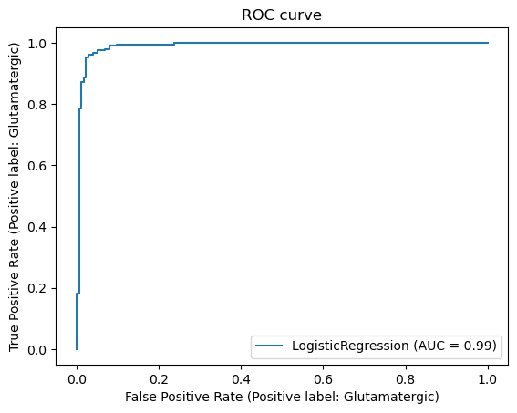
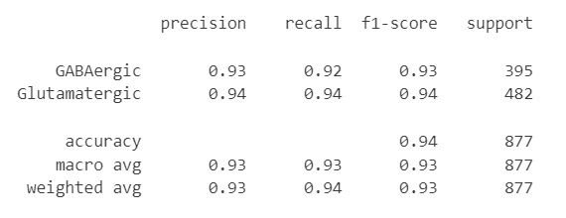
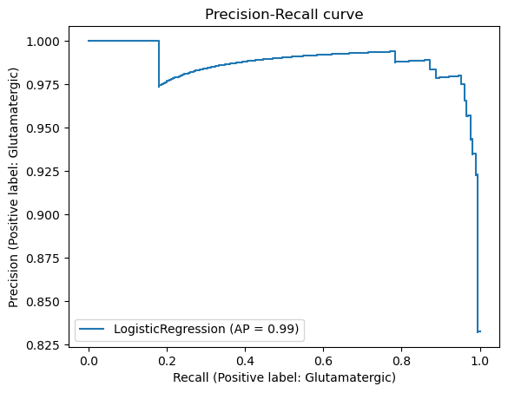
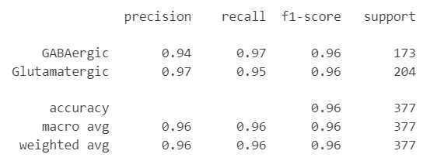
Basic Machine Learning Model
Supervised learning- logistic regression:
Train performance
Good performances ☺
Test performance

Slide 13

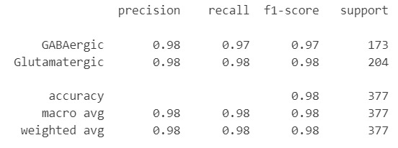
Improved Machine Learning Model
Supervised learning- logistic regression:
Hyperparameter optimization:
GridSearch: no improvement
Threshold adjustment: improvement- accuracy increased from 0.96 to 0.97
Looking back, was removing the features helpful?
Running the model on the unfiltered data:
Surprisingly, we got better performences– an accuracy of 0.99
Too good to be true? Mean Cross-validation score: 0.98

Slide 14
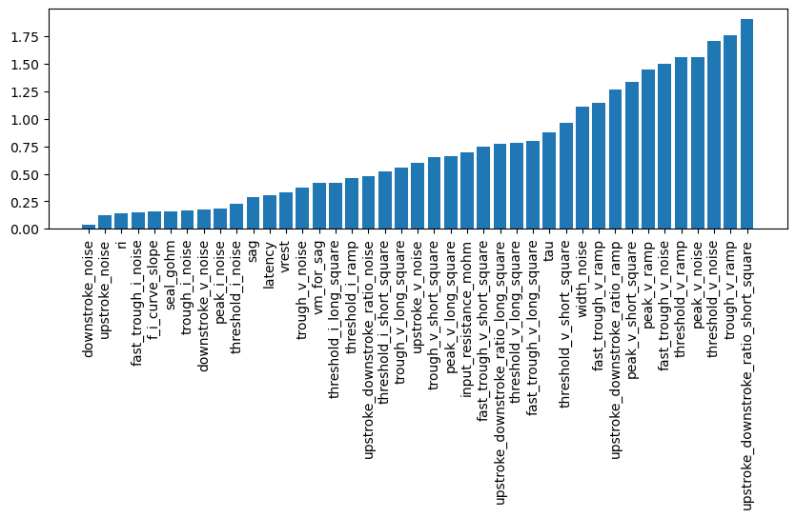
Improved Machine Learning Model
Supervised Learning- Logistic Regression:

Slide 15
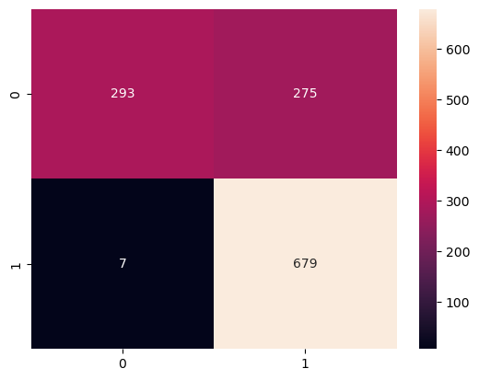
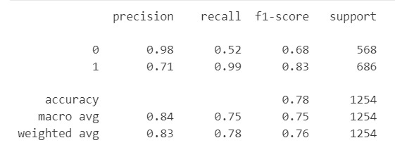
Basic Machine Learning Model
Unsupervised learning – KMeans model
Quite good results, but not satisfying
To improve the performance, we will try dimensionality reduction

Slide 16
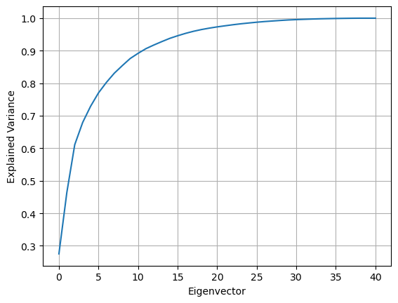
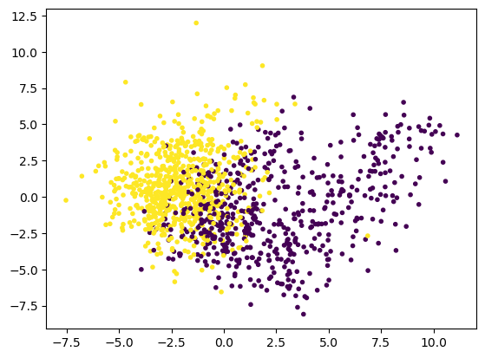
Improved Machine Learning Model
Unsupervised learning- KMeans model
Dimensionality reduction with PCA
n_components=2
n_components=20
Accuracy = 0.79
Accuracy = 0.78
No major changes
Let`s try to use a non-linear approach

Slide 17
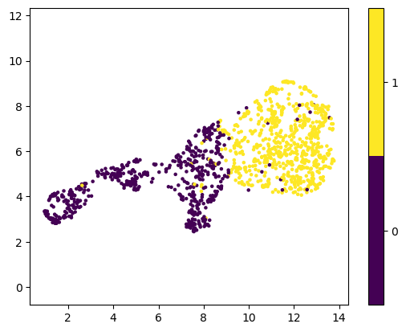
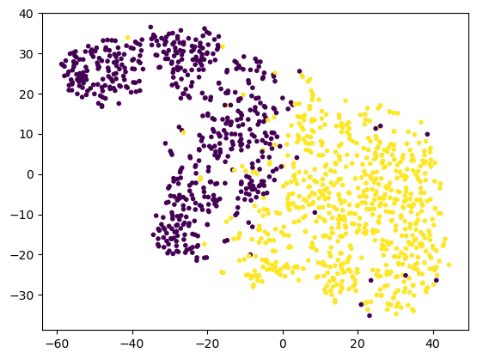
Improved Machine Learning Model
Unsupervised learning- KMeans model
Dimensionality reduction with UMAP
Dimensionality reduction with t-SNE
n_components=2
n_components=2
Accuracy = 0.91
Accuracy = 0.96
Better results, best results for t-SNE

Slide 18
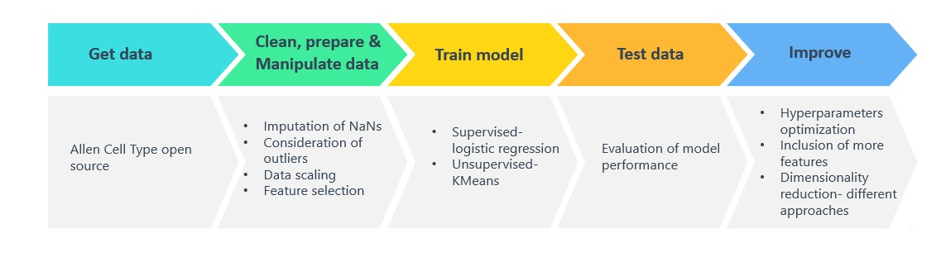
Summary of work process
Workflow

Slide 19
Final Analysis
Conclusion
Two ML approaches yielded good results. supervised and unsupervised
Supervised: We achieved an accuracy of 98% using the logistic regression model with optimized conditions
Unsupervised: We used the K-Means and compared different approaches to dimensionality reduction (PCA, UMAP, t-SNE). We achieved 96% accuracy with t-SNE
Overall, the results indicate that the data is informative and allows us to classify neurons according to their electrical activity into the type of function they perform (excitatory / inhibitory)

Slide 20
References
“Allen cell type.” https://celltypes.brain-map.org/data?donor__species=Mus musculus
Armañanzas, R., & Ascoli, G. A. (2015). Towards the automatic classification of neurons. Trends in neurosciences, 38(5), 307-318.‏
Becchetti, A., Gullo, F., Bruno, G., Dossi, E., Lecchi, M., & Wanke, E. (2012). Exact distinction of excitatory and inhibitory neurons in neural networks: a study with GFP-GAD67 neurons optically and electrophysiologically recognized on multielectrode arrays. Frontiers in neural circuits, 6, 63.‏
Oliveira, A. M., Coelho, L., Carvalho, E., Ferreira-Pinto, M. J., Vaz, R., & Aguiar, P. (2023). Machine learning for adaptive deep brain stimulation in Parkinson’s disease: closing the loop. Journal of Neurology, 1-14.‏
Petroff, O. A. (2002). Book review: GABA and glutamate in the human brain. The Neuroscientist, 8(6), 562-573.‏

